Slide 1
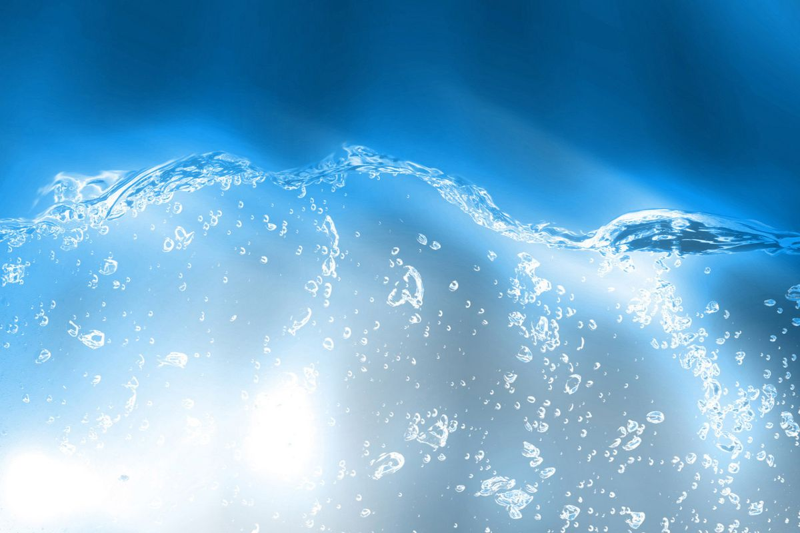
Humpback Whale Identification
Using Machine Learning Algorithms for Computer Vision
March 15, 2019
ML1020 CloudStarter : A. Asghar, S. Lee, J. Mitroi, V. Muriyanat

Slide 2
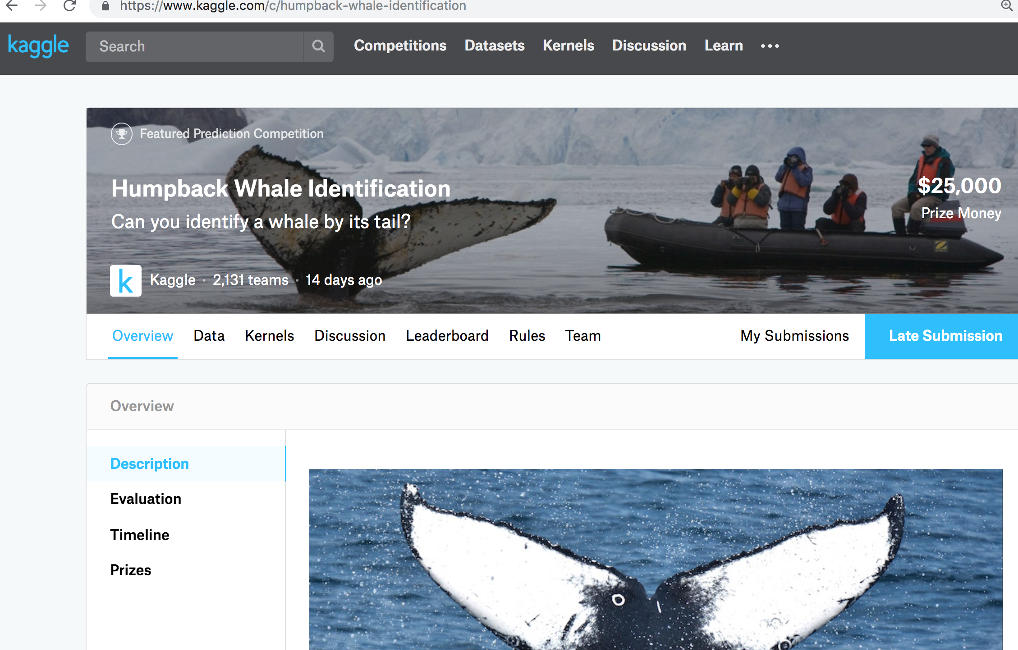
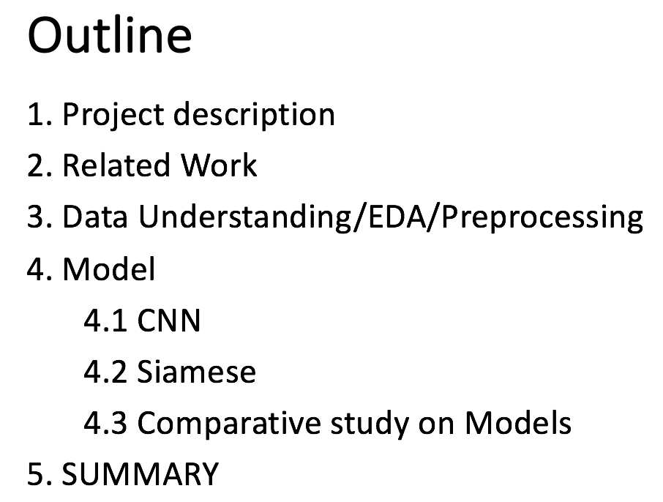

Slide 3
１．Project Description
1. Humpback Whale Identification
Helps the whale conservation efforts by improving the monitoring of whales using an automated image identification system
Data profile: from Kaggle, size 25K+
2. How are Whales identified?
By their tail flukes
3. How can ML play role in this?
Using algorithms that process patterns in images,
automate photo (image) identification of whales

Slide 4
２. Related Work : Earlier effort- Manual feature extractions
1979: 1st effort of recognition by Photos. [Katona et al]
1990: Code assigned to fluke patterns [Mizsroch et al]
2000: Curve-matching technique (for dolphins) [Araabi]
2004: Use of the interface that does feature vectorizing. [Ranguelova et al]
2010: Software to compare queried images to catalogued images [Kniest&Burns]
2015: GUI to search by user selection of set fluke types.[WhaleNet]

Slide 5
２. Related Work : AUTOMATIC feature extractions by ML
ML utilization effort is enhanced by competitions such as Kaggle.
“The Right Whale Recognition” competition
=Methodology examples=
Image used: aerial shot of a right whale, face
Algorithm: CNN,
CNN-based pretrained model
(AlexNet, DeepSenseNet)
Useful examples of automated identification of whales based on images
But not directly applicable to few-shot learning (classes with few examples)

Slide 6
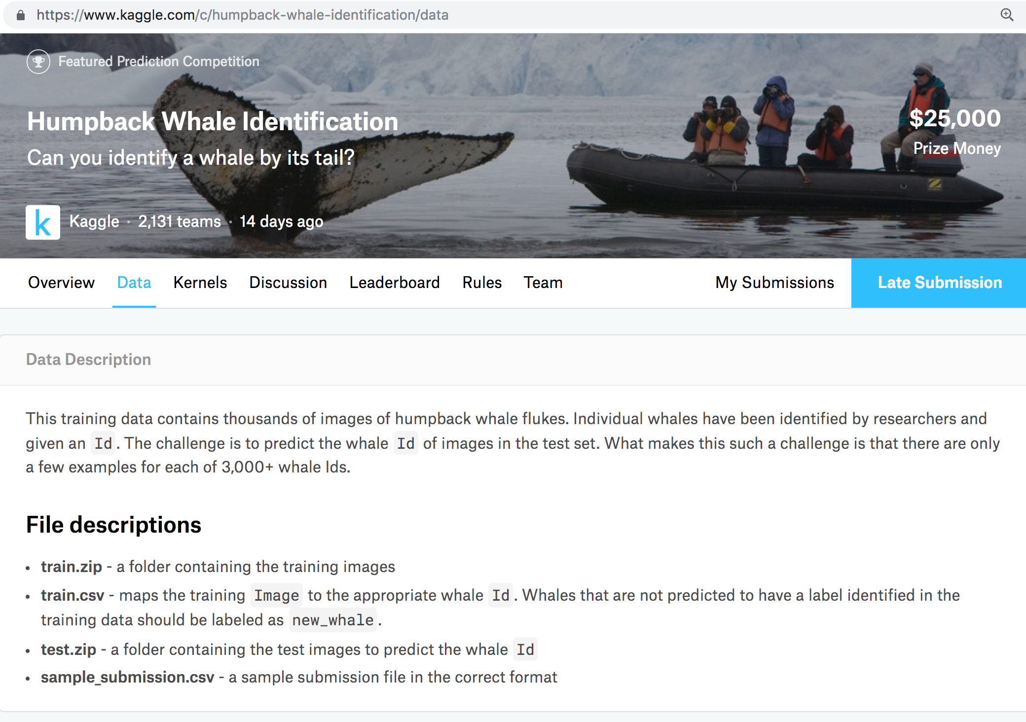
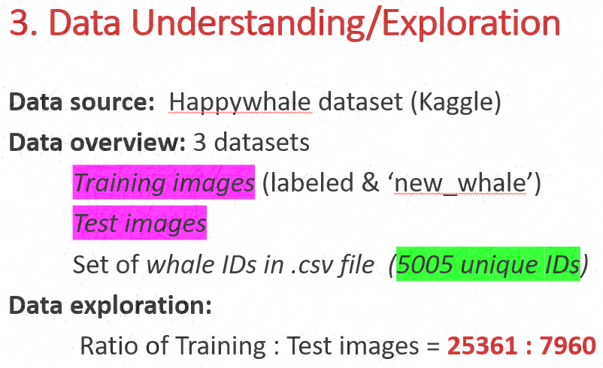

Slide 7
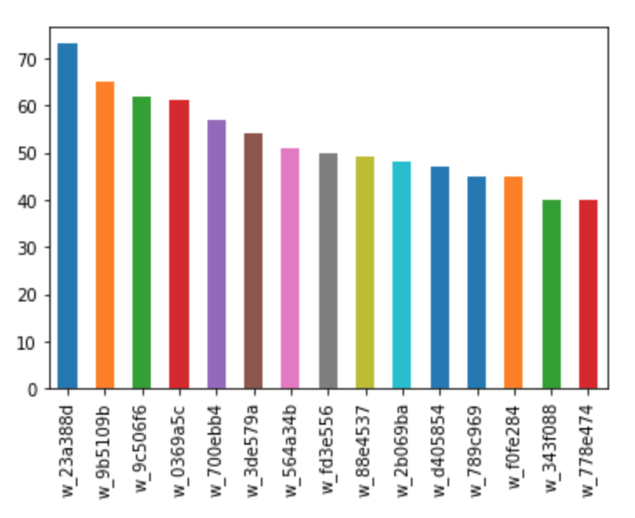
3. Data Exploration: Numeric Data
Skew of training image distribution: Few-Shot Learning problem
More than 2000 whales have just one image
Single whale with most images has 73 images
Most frequent IDs (without counting new_whale)
→

Slide 8
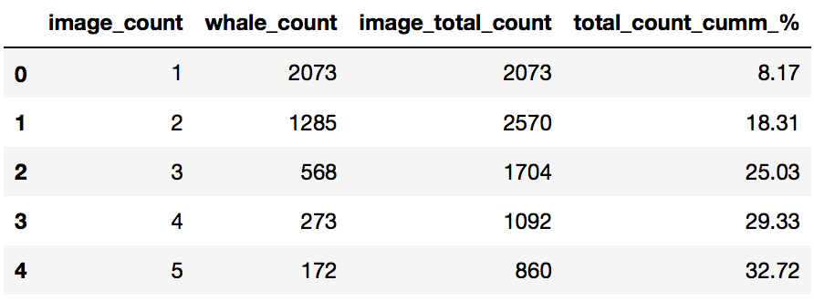
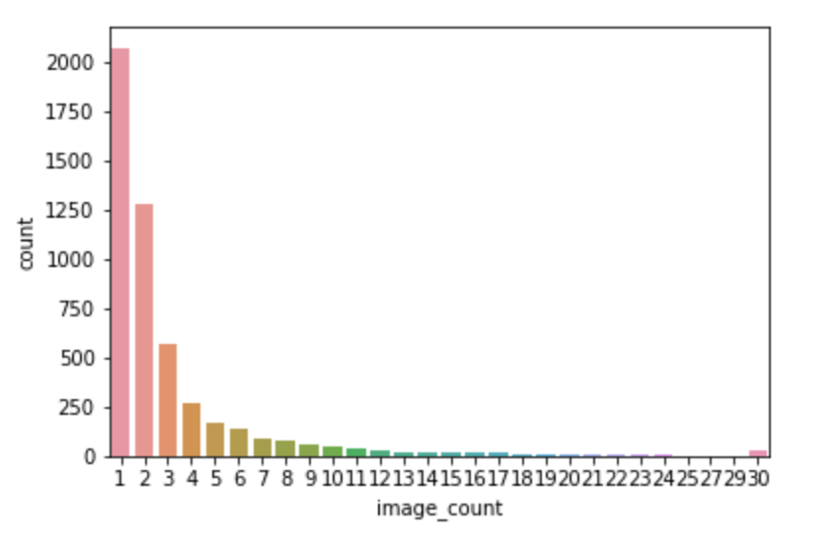
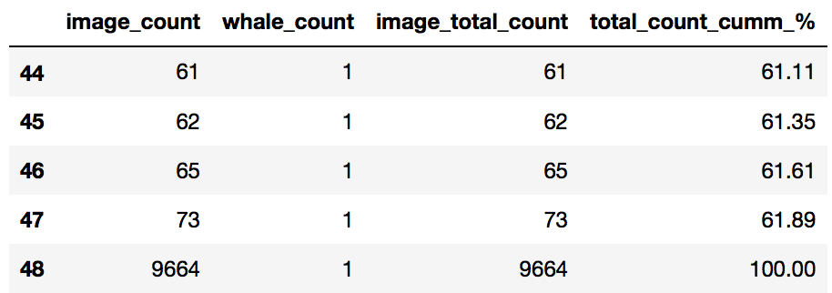
3. Data Exploration: Numeric Data
Whales assigned
1 to 4 images: 30%
(%)
(%)
Whales assigned 5 to max.73 images 30%
Whales with ID*
“new-whale”: 41.41%

Slide 9
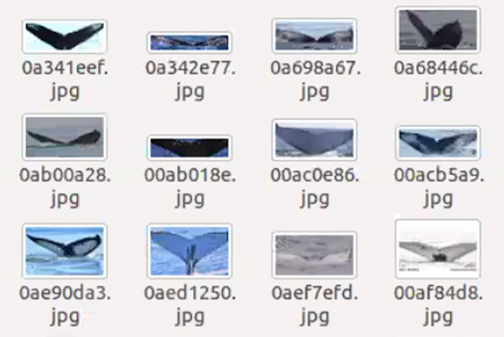
3. Data Exploration: Image Data
Visual inspection of image quality
Pixel resolution differs between
the images
Rectangular shape of images
suggests that most images have
been cropped (by Happywhale)
to center the fluke better

Slide 10
3. Data Pre-Processing
Preprocessing for CNN
Image preprocessing over the training images (Keras)
1. Transform to: Size - 100 x 100x 3 pixels
Data type - array
2. Generate labels by one-hot encoding
Preprocessing for Siamese Network
Keras normalization by bringing image pixels in the 0 - 1 range

Slide 11
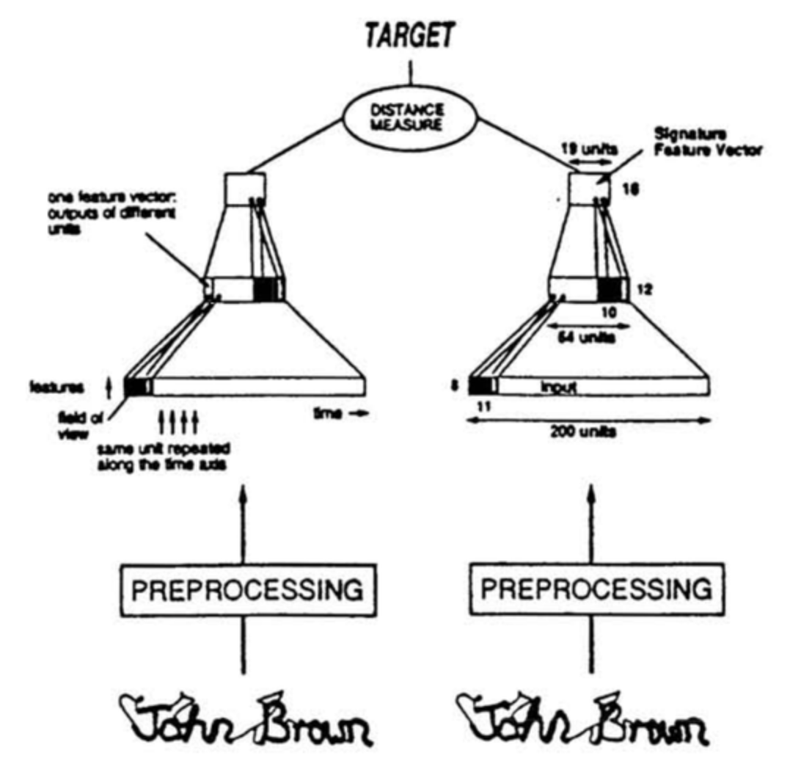
4. Classifier Models Build
CNN
SIAMESE

Slide 12
4. Classifier Models Build
Siamese
NN with 2+ identical subnetworks
What is “identical” in subnetworkS?
Parameters & Weightss
Effective in:
Discovery of Similarity/Relationship
(so works for detection of duplicate )

Slide 13
4. Modeling
4.1. CNN
Convolution 1
Pooling/Downsampling
Convolution 2
Flatten
FC
94
47
45
100
45
4251 x 1
32
47
64
14400 x 1
100
94
3
32
Kernel/Filter: 64 filter of 3x3 with Stride of 1
Kernel/Filter: 32 filter of 7x7 with Stride of 1

Slide 14
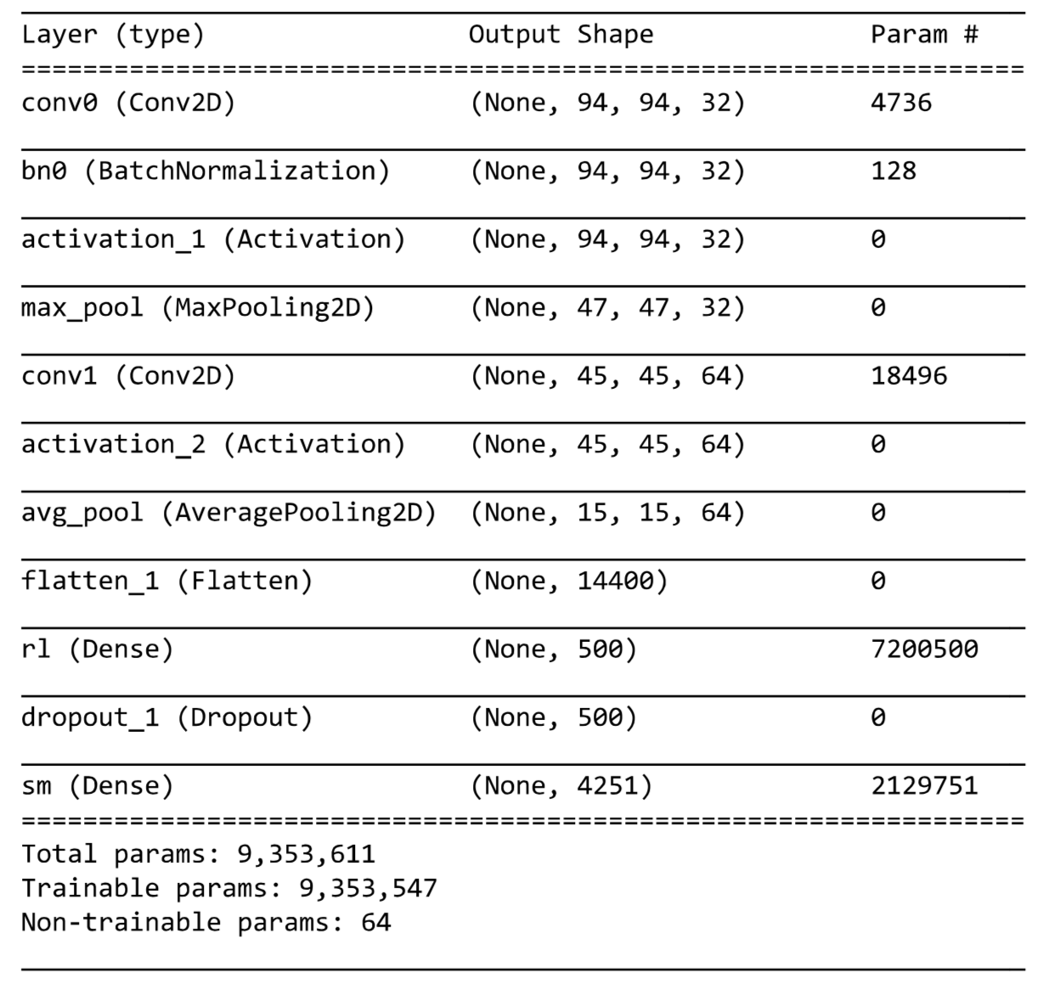
4. Modeling
4.1. CNN
Optimizer: Adam
(does better than SGD)
Pooling used to help
Model generalize
Relu activation function -
All non zero output
removed

Slide 15
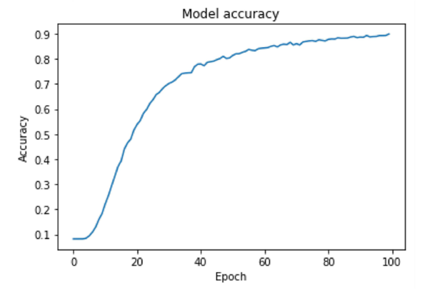
4. Modeling
4.1. CNN : Result
After 100 epochs:
Loss: 0.4 Accuracy 89%
Data Augmentation attempted
Results were very poor:
Accuracy of 45%

Slide 16
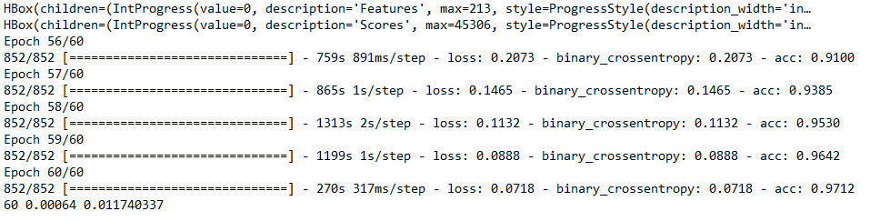
4. Modeling
4.1 Siamese
Used a pre-trained weights. (The one from the Kaggle winner Martin Piotte)
Uses a bounding box to center the image in the frame
Transformation (shear, rotation) seems to have helped.
# of Epochs: 60 Accuracy: 97.12%

Slide 17
What is Siamese Neural Network
Variant of CNN
Class of NN that contain 2 or more identical subnetwork
They have the same configuration with same parameters and weights
Parameter updating is mirrored across both subnetworks
Popular for tasks that involve finding similarity b/w 2 comparable things
Best suited for few-shot learning (low class cardinality in training data)

Slide 18
CNN v/s Siamese NN
Uses a n/w of layers to learn the weights
Unlike other classification techniques, doesn’t use probability distribution to do the classification
Instead, S. NN, learns the function that measures similarity b/w 2 images
Leverages Euclidean geometry to image comparison

Slide 19
Siamese NN – Under the Hood
Projects the image into n-dimensional Euclidean coordinate space
Finds the distance b/w the images under comparison
Top Model
Uses the Euclidean distance computed above to predict the class(es) of images that they belong to
Bottom Model

Slide 20
Loss Function
The Top Model uses Triplet loss as the loss function
+ve eg of an image being compared to
(same class as that of the anchor)
Image used for comparison
(aka anchor point)
-ve eg of an image being compared to
(different class as that of the anchor)
The goal of the learning process: Find possible triplets where the +ve eg is geometrically closer to the anchor than the -ve

Slide 21
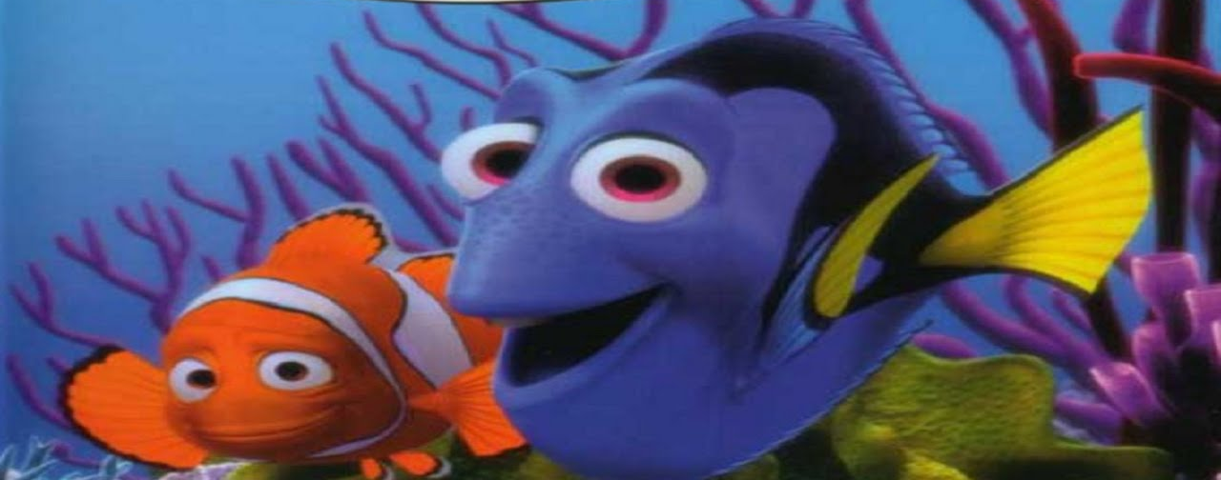
Finding Triplets
(aka Triplet Mining)
Exhaustive Search
(aka offline mining)
Do it in batches
(aka online mining)

Slide 22
4. Modeling Results
4.3. Comparative study on the Models experimented
Accuracy: 89%
Accuracy: 97.12%
FINDINGS
Siamese > CNN
Further data cleaning/pre-process enhance CNN performance.

Slide 23
5. SUMMARY
Conclusion on the Whale Image Classification
Challenge: Computationally intensive.
Adding of new classes to the dataset.
Performance can improve by more Preprocessing of Image
Data Preparing & Cleaning is important
Key-Takeaway

Slide 24
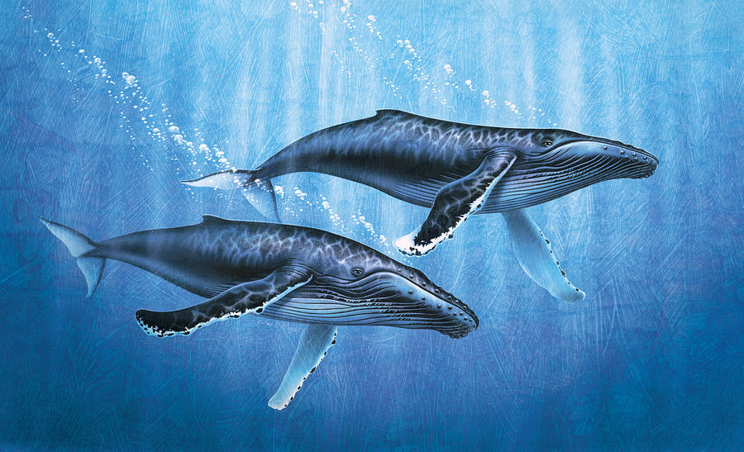
THANK YOU

Slide 25
Appendix

